Slide 1

Submitted by:
Md.Tamim Hasan Toha
Roll: BSSE-1424
SUDOKU
Supervised by:
Dr. Ahmedul Kabir
Associate Professor
IIT,University of Dhaka

Slide 2
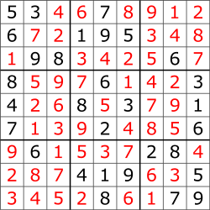
ABOUT SUDOKU
Sudoku is a popular logic-based number puzzle that is often found in newspapers.
The objective of Sudoku is to fill a 9x9 grid with numbers so that each row, each column, and each of the nine 3x3 subgrids contains all of the digits from 1 to 9 without repetition.
A Solved Sudoku Grid

Slide 3
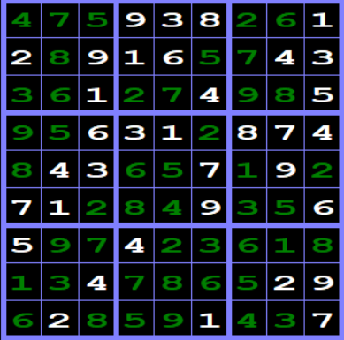
DIAGONAL SUDOKU
Diagonal Sudoku demands that each of the two main diagonals must have unique numbers from 1 to 9.
A Diagonal Sudoku Grid

Slide 4
ABOUT THE PROJECT
Generate sudoku puzzle
Solve a sudoku puzzle
Let user solve the puzzle
Timer and Scoring
Save and load
Hints

Slide 5
1.Generate new puzzle:
The program will be able to generate unique puzzle in each run according to the user's selected difficulty level.
2.Solve a sudoku puzzle:
The program will be able to take puzzle input from the user and solve the sudoku puzzle and display it.

Slide 6
3.Let user solve the puzzle:
An user will be able to experience a real life sudoku game.
4.Timer and scoring:
There will be a scoring system based on the time and number of moves taken by the user.

Slide 7
5.Save and Load:
The user will be able to save the unsolved sudoku and reload it and solve it later.
6.Hints:
The user will be able to take hints while solving the puzzle.

Slide 8
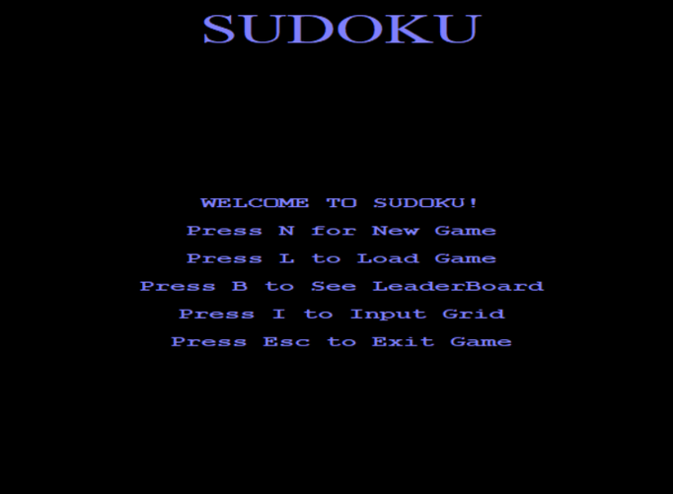
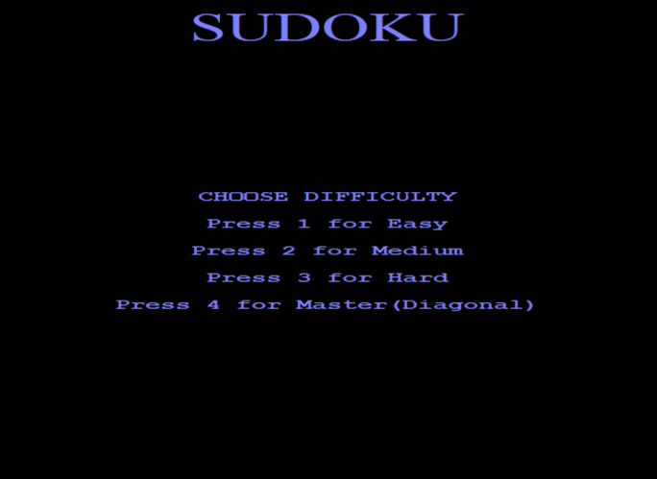
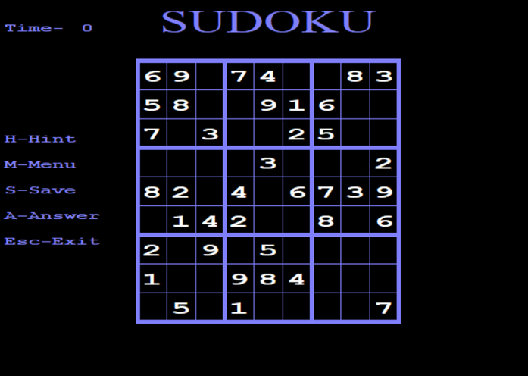
Functions:
Difficulty Screen
Menu screen
New Game
New Puzzle

Slide 9
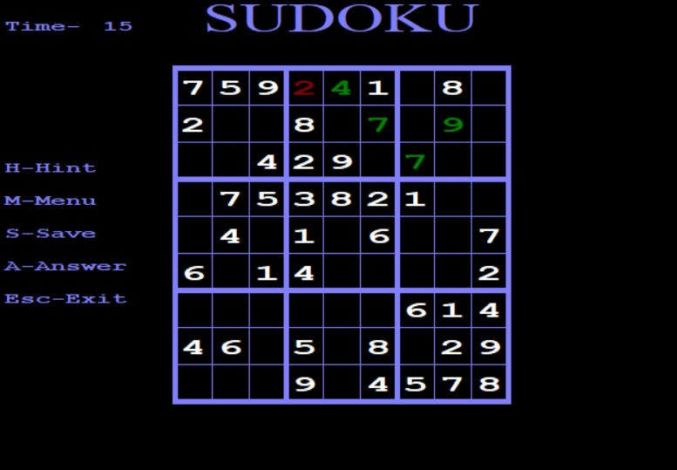
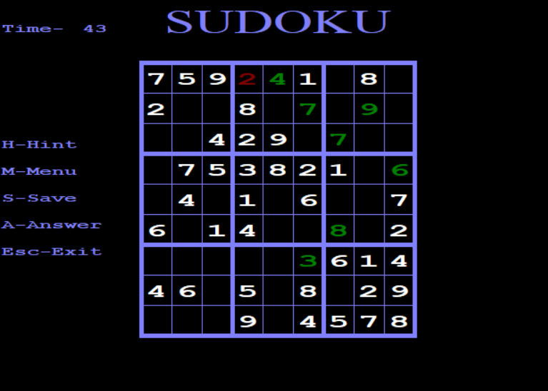
Functions:
Time is being updated after each input
Taking User Input

Slide 10
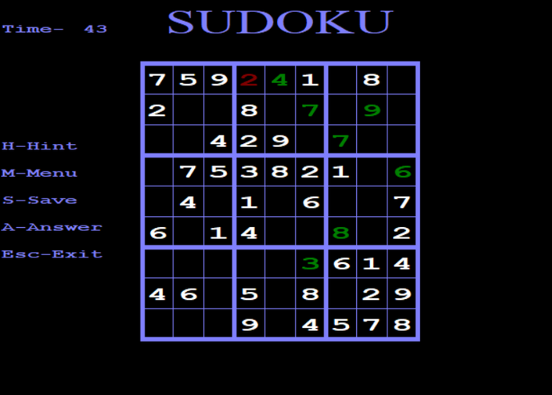
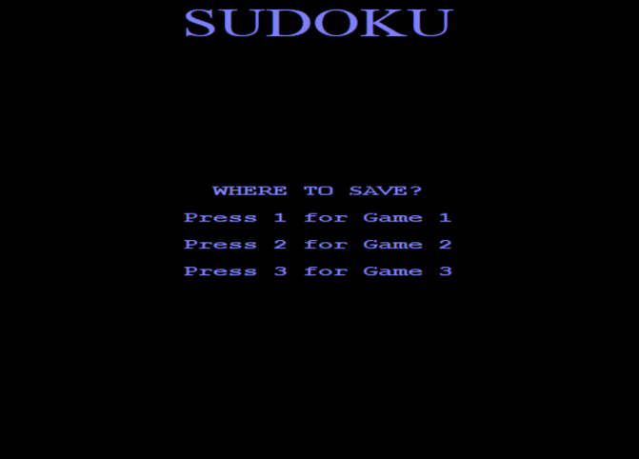
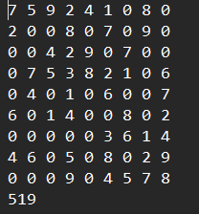
Functions:
Saving to Game 1
Game 1 File

Slide 11
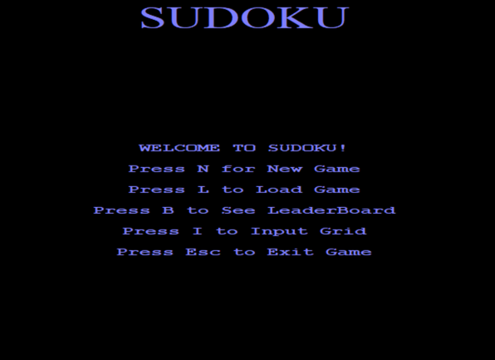
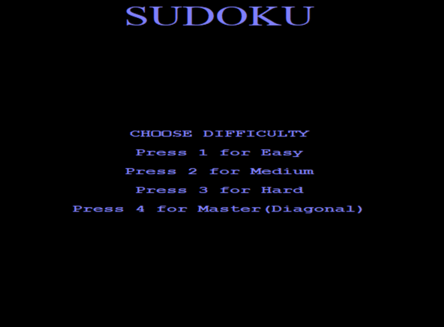
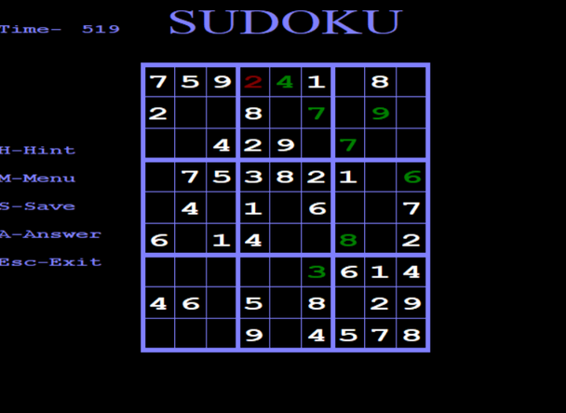
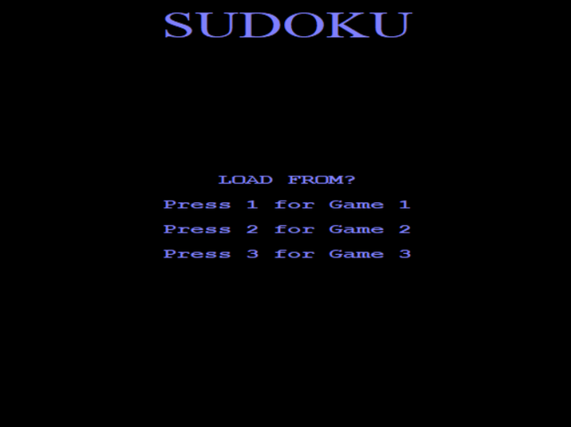
Functions:
Load Game
Master
Game 1
Loaded Game

Slide 12
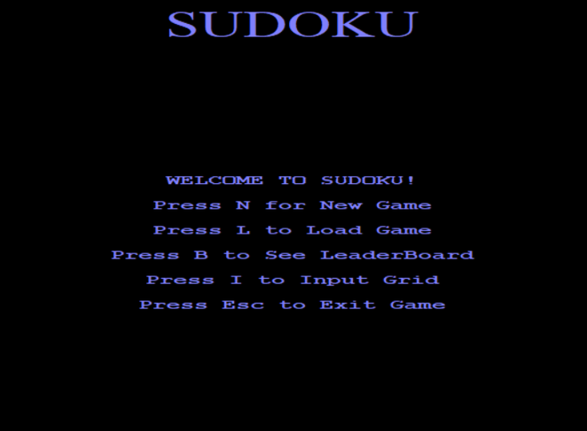
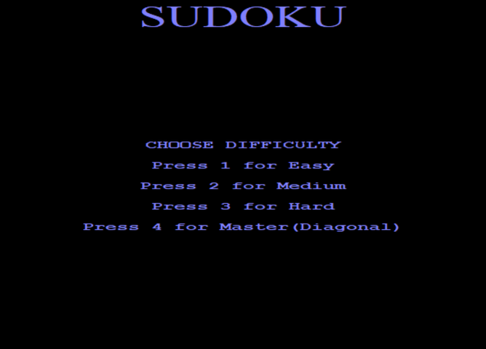
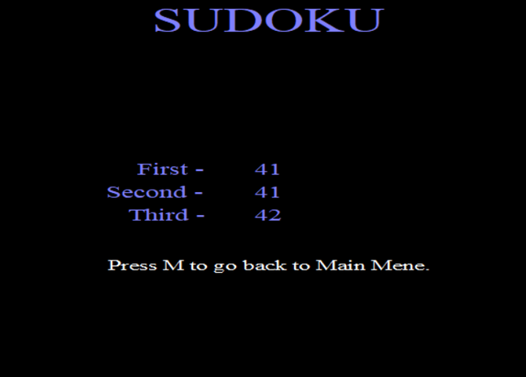
Functions:
Leaderboard
Master

Slide 13
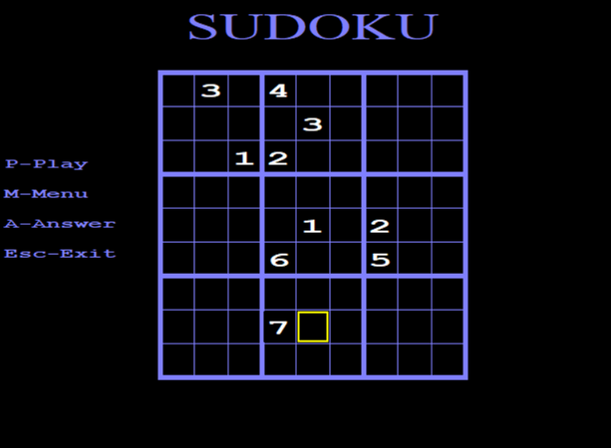
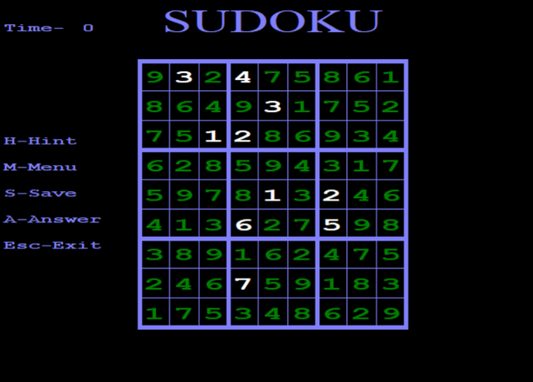
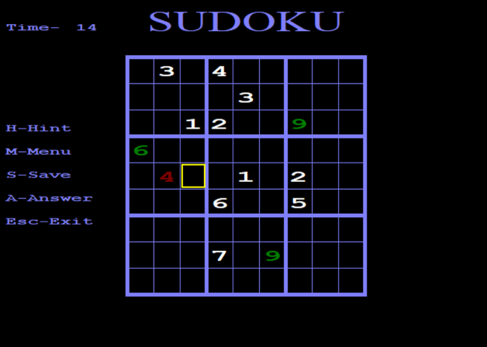
Functions:
Input Grid
Play Game
Solve

Slide 14
Challenges Faced
1.Maintaining a large project
2.User Interface Design
3.Debugging

Slide 15
THANK YOU

